Slide 1
AVR Architecture 2 – ATMEGA 328
Dr.Sreejith Rajan

Slide 2
Introduction
What is AVR?
Architecture by Alf-Egil Bogen and Vegard Wollan.
Family of 8-bit RISC microcontrollers
Developed by Atmel (now Microchip)
Widely used in Arduino boards, embedded systems, and consumer electronics

Slide 3
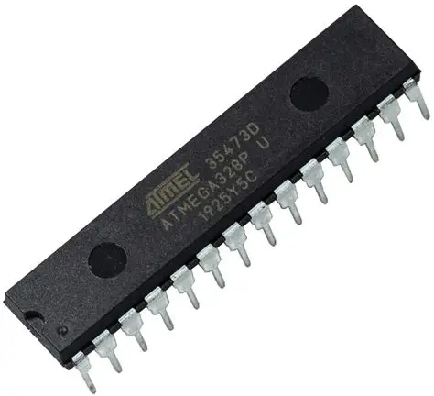
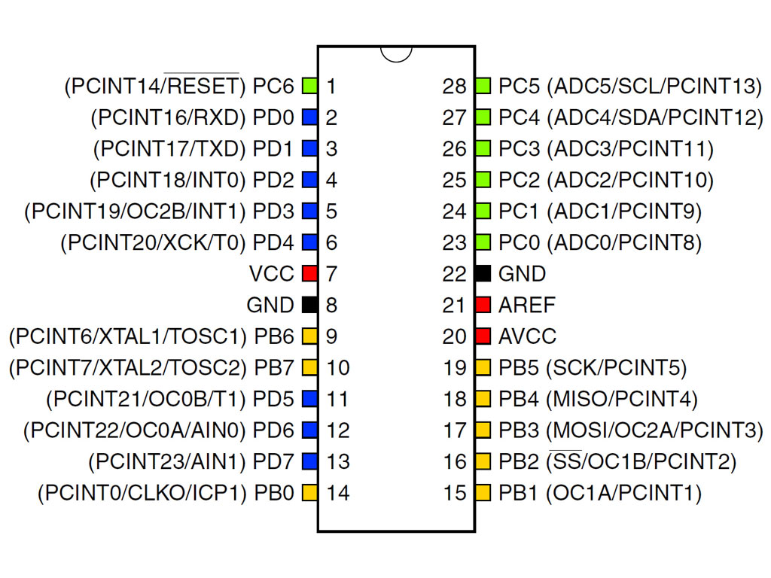
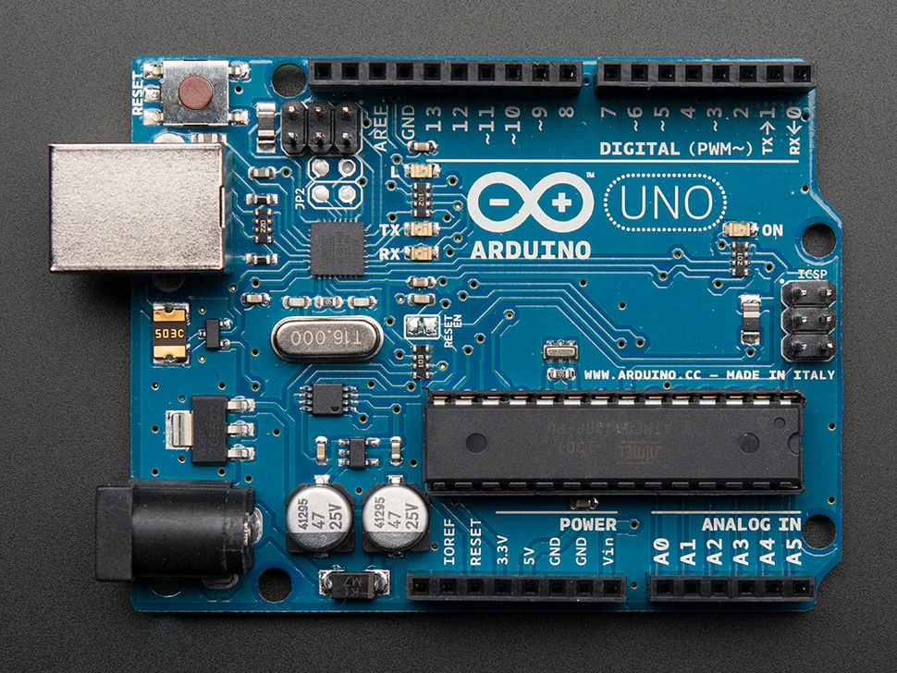
ATMEGA 328
0
1

Slide 4
ATMEGA 328 – GPIO Programming
4 Things to remember
Data Direction Register(DDRx) register
0 means that the pin is INPUT. 1means that the pin is OUTPUT
PORTx register (outputting value to a pin)
PINx Register (inputting value through a pin)
Bitwise operations
0

Slide 5
ATMEGA 328 – GPIO Programming
Pull Up Resistor : A pull-up resistor is a resistor that connects an input pin to the positive supply voltage (Vcc).
Its job is to make sure the pin has a defined logic level (HIGH = 1) when the switch is open (not pressed).
0

Slide 6
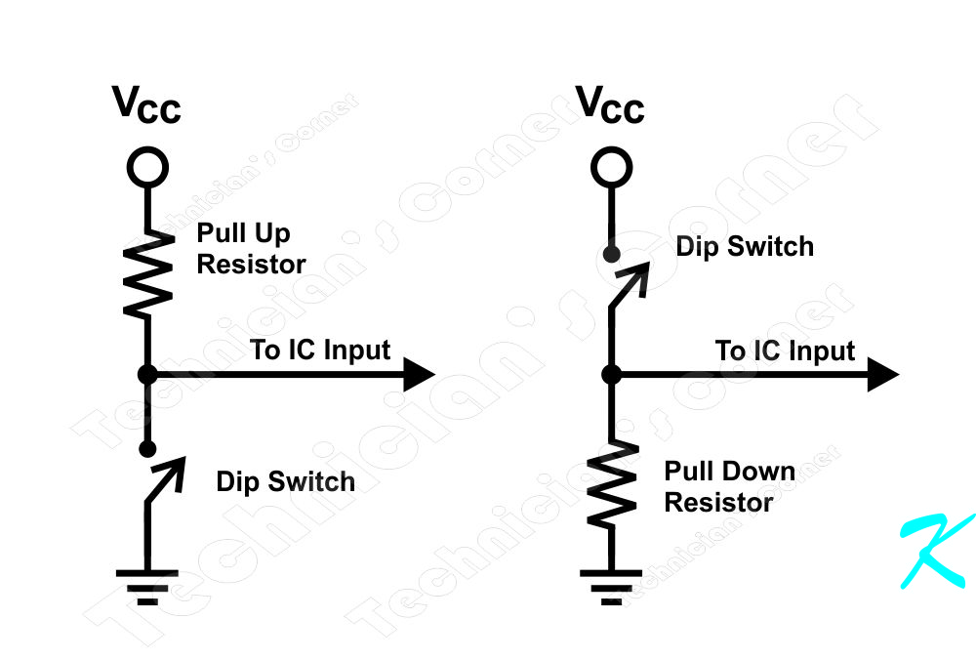
ATMEGA 328 – GPIO Programming
Pull-down resistor : is the opposite of a pull-up.It connects an input pin to ground (GND) through a resistor, ensuring the pin reads LOW (0) when the switch is open.
0

Slide 7
ATMEGA 328 – GPIO Programming
Let’s code
0

Slide 8
5V
PB5

Slide 9
THANK YOU

